Slide 1
Parallel Computing for Enhanced Pneumonia Detection in X-Rays
Northeastern University
CSYE 7105 33798 - High-Performance Parallel Machine Learning and AI, Spring 2024
Instructor: Prof Handan Liu
Team 12
Tanmay Joshi & Devanshu Gohil

Slide 2
Contents
Introduction
Background
Motivation
Goals
Dataset
EDA
Methodology
EDA using Multiprocessing
Model Selection – DenseNet - 161
Model Training using Distributed Data Parallel
Model Evaluation using Dask
Training
Result and Analysis
Conclusion
References

Slide 3
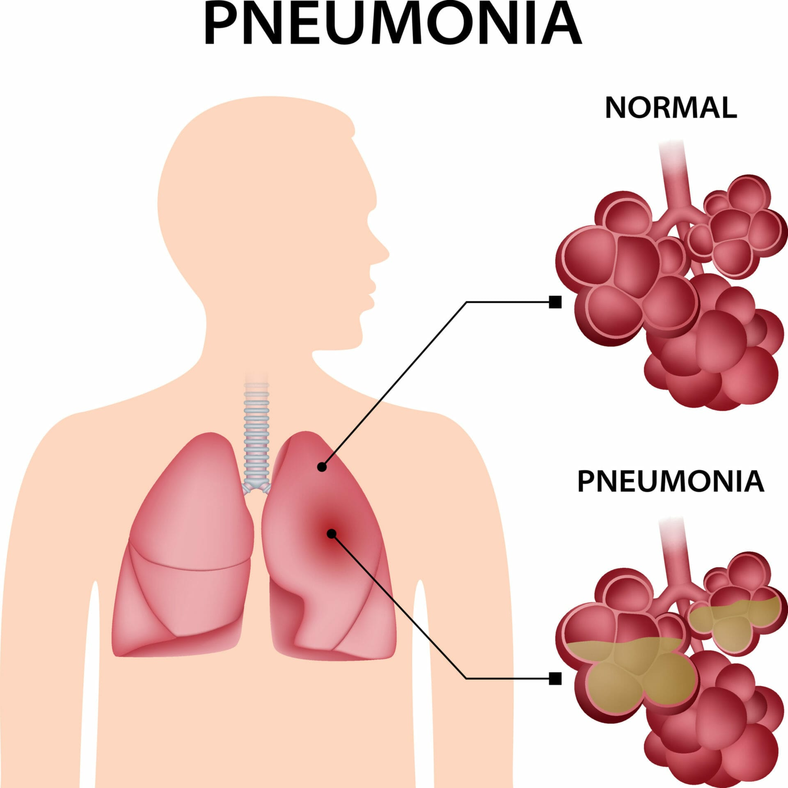
Background
Pneumonia is a serious lung infection affecting many globally, especially the young and old. Timely and correct diagnosis is critical for treatment, but conventional X-ray reading methods are slow and inconsistent in accuracy.
Hence, due to advancement in technology and AI, modern solutions include classification of patients’ images using deep learning models

Slide 4
Motivation
Pneumonia, a major global health issue, especially impacts the young and old; swift and precise X-ray diagnosis is key to lowering mortality.\
Manual analysis of X-ray images is time-intensive and challenging for radiologists.
Machine Learning advancements offer solutions to improve the detection process.
Processing and training with large datasets demand significant computational power.
This project aims to use parallel computing to quicken and scale the analysis effectively

Slide 5
Goals
The aim of our project is to engineer a deep learning model that operates in parallel to classify weather images. The objectives include:
Model Design: Craft a deep learning architecture specifically tailored for the intricate task of Pneumonia image classification.
Parallelization Implementation: Apply various parallel computing techniques to bolster the model's training process, thereby increasing speed.
Performance Analysis: Conduct a thorough evaluation and interpret the efficacy of each parallelization strategy across different stages of the model's workflow.

Slide 6
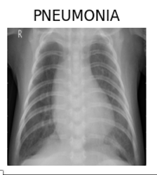
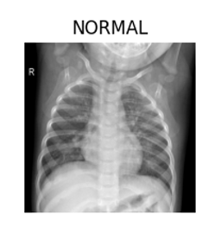
Dataset
The dataset is titled “Pediatric Pneumonia Chest X-ray” and is publicly available on Kaggle.
It consists of 5,863 X-Ray images categorized into pneumonia and normal conditions.
The images are grayscale and vary in size. For this project, images will be resized to a standard dimension to ensure uniformity.

Slide 7
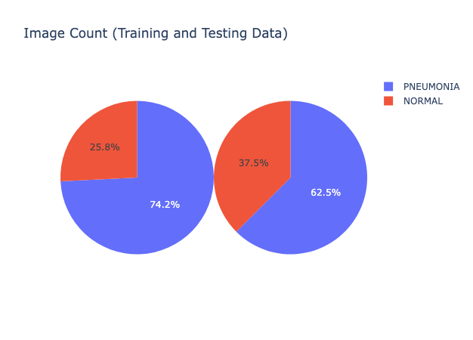
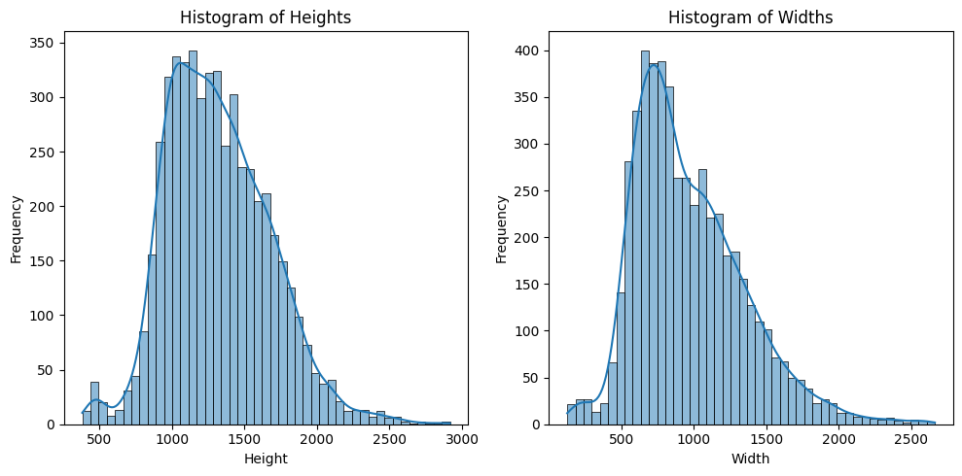
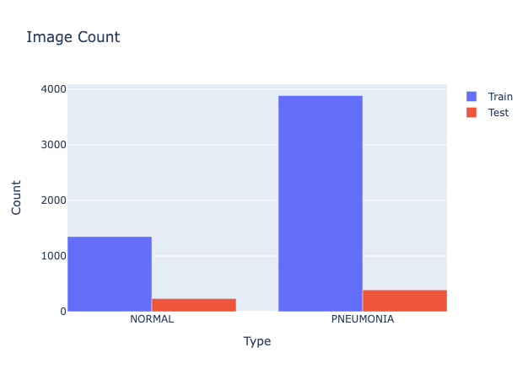
EDA(Exploratory Data Analysis)

Slide 8
Methodology
EDA using Multiprocessing
Model Selection – DenseNet - 161
Model Training using Distributed Data Parallel
Model Evaluation using Dask

Slide 9
EDA using Multiprocessing
EDA is essential for analyzing and cleansing data to guide the transformation choices during model training, ensuring optimal machine learning performance.
The primary challenge was the time-consuming process of loading approximately 6000 high-quality images for EDA.
Implemented Python’s multiprocessing library, specifically multiprocessing.Pool, to expedite the dataset loading process.
allowed distribution of image loading across multiple CPU cores, significantly reducing the time required versus sequential loading.

Slide 10
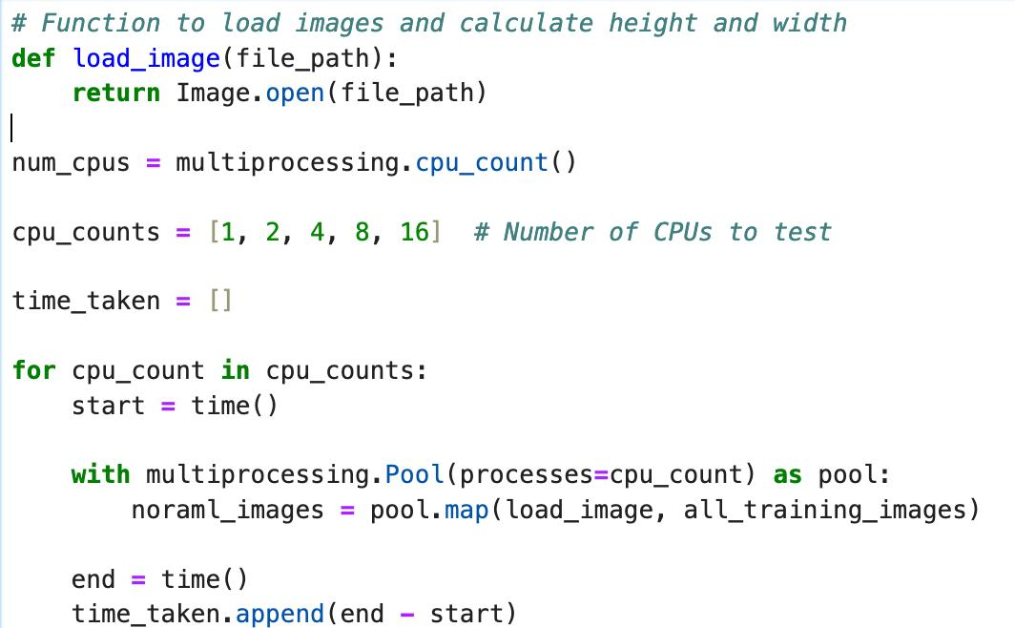
How?
Tested how well multiprocessing.Pool worked by running on 1,2,4,8,16 CPU cores, and found that more CPUs made data loading much faster.
tests showed that using more CPUs cut down the time needed to load data.
With more CPU cores, image loading became quicker, which is important for projects where time matters.

Slide 11
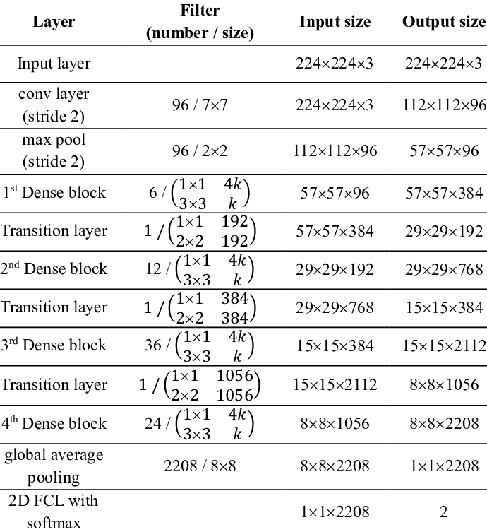
Model Selection: DenseNet-161
DenseNet-161's depth improves complex image classification.
Dense connections in DenseNet-161 help prevent gradient issues and strengthen feature learning.
The network's design reduces parameters, increasing efficiency for medical imaging.

Slide 12
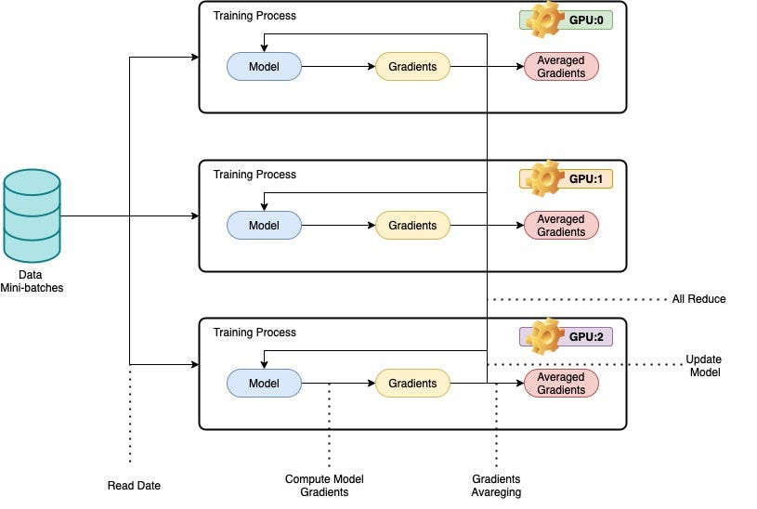
Model Training using Distributed Data Parallel
The method meets real-world needs by efficiently handling extensive datasets necessary for complex tasks like pneumonia detection in chest X-rays.
DDP accelerates training by dividing data and independently processing it on each GPU, with synchronized updates for consitency .
To use DistributedDataParallel on a host with N GPUs, you should spawn up N processes, ensuring that each process exclusively works on a single GPU from 0 to N-1.

Slide 13
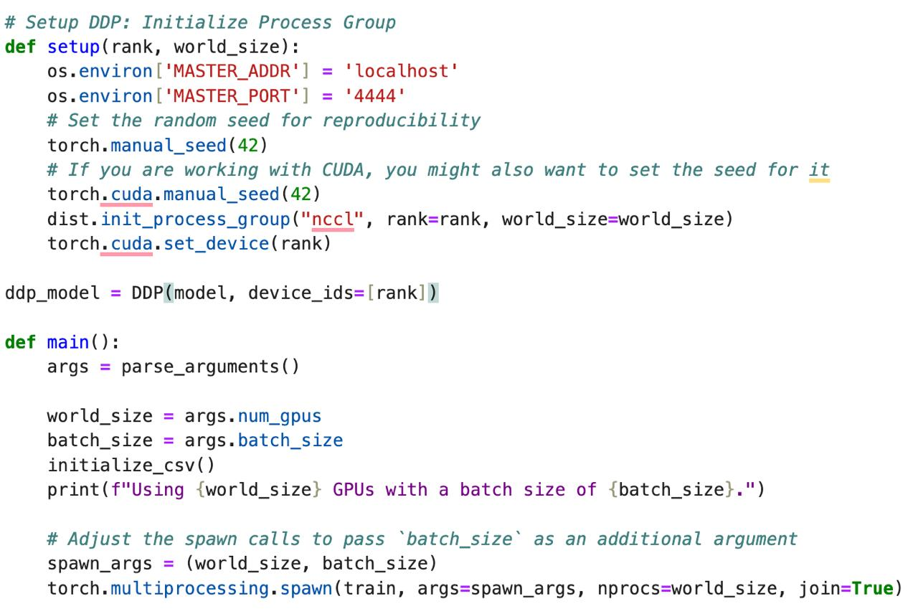
How?
Fitted the model for training across 4 GPUs for batch sizes of 32, 64, 128, 256 respectively.
Recorded the training times for model execution on 1, 2, 4 GPUs respectively.
Single-GPU setups showed increased training times with larger batch sizes, suggesting a cap due to limited computational power.
Four-GPU arrangements revealed the best use of DDP, with training times dropping as batch sizes increased, showcasing efficient distribution and scalability.

Slide 14
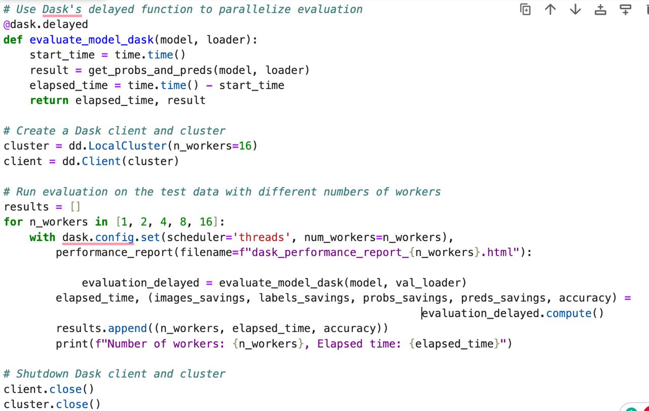
Model Evaluation using Dask
Implemented parallel evaluation of the deep learning model on test data utilizing Dask's delayed function across several workers for enhanced efficiency.
Reduced total computation time by distributing workload across multiple workers.
Created a Dask client and cluster for managing parallel computations.
Varied the number of workers to assess model performance under different computational loads.

Slide 15
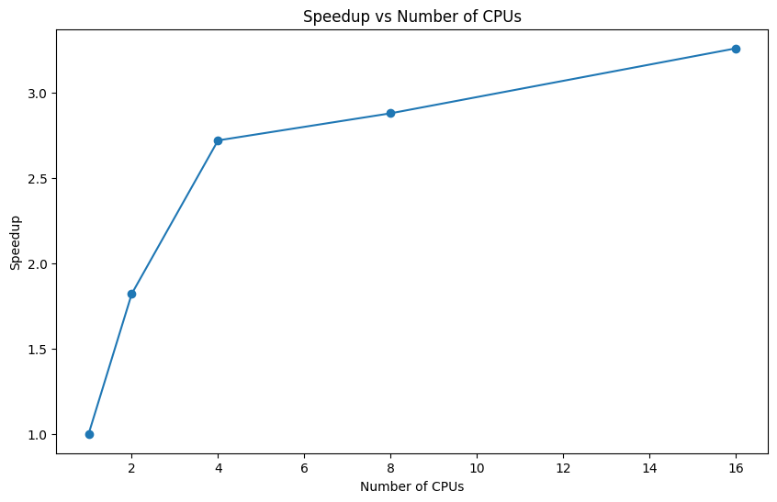
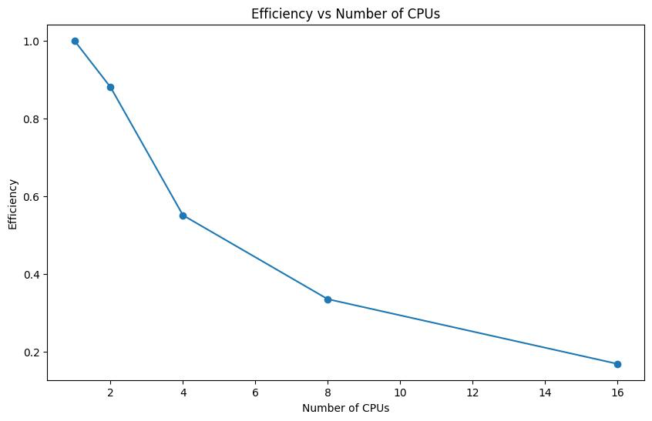
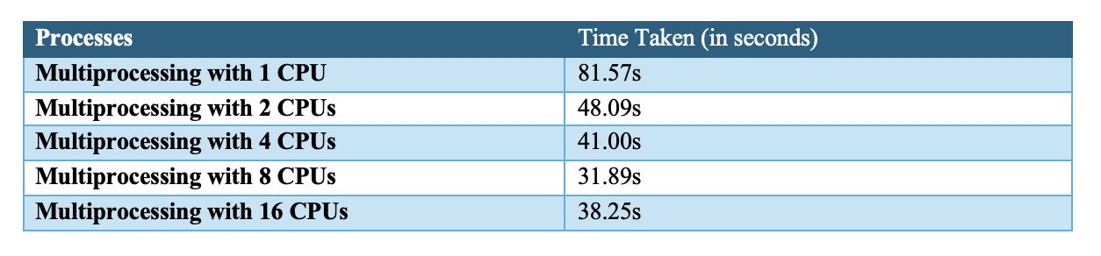
Results: EDA parallel

Slide 16
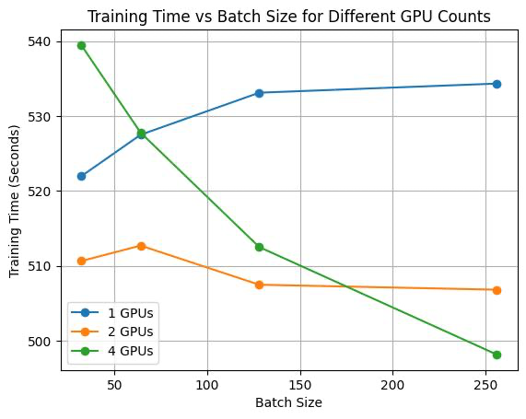
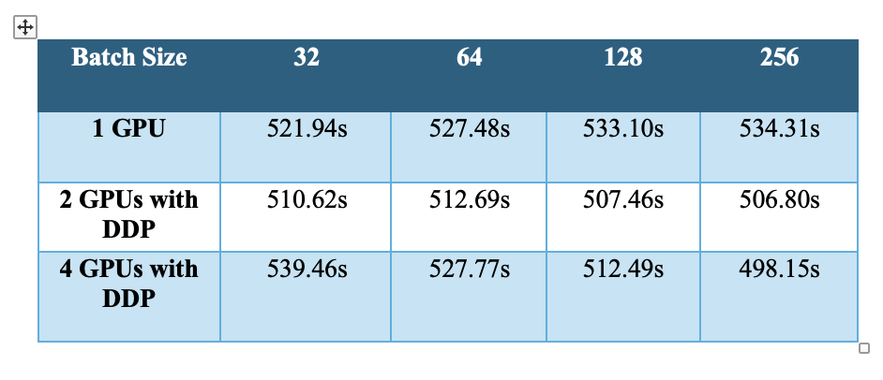
Results: DDP Training
Trained on NVIDIA Tesla V-100-SXM2 GPUs
Model trained on 1, 2, 4 GPUs for batch size 32, 64, 128,256

Slide 17
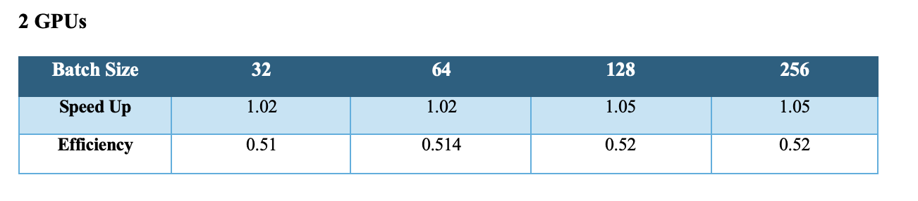
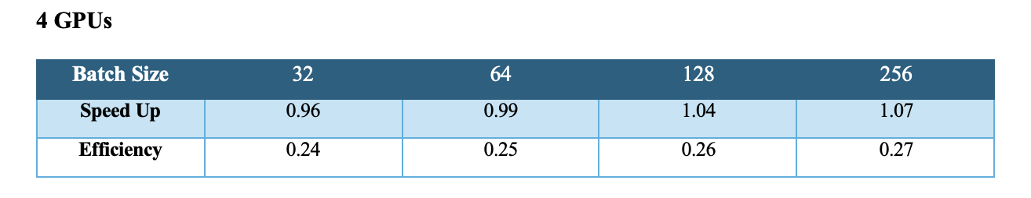
Speedup and Efficiency using DDP

Slide 18
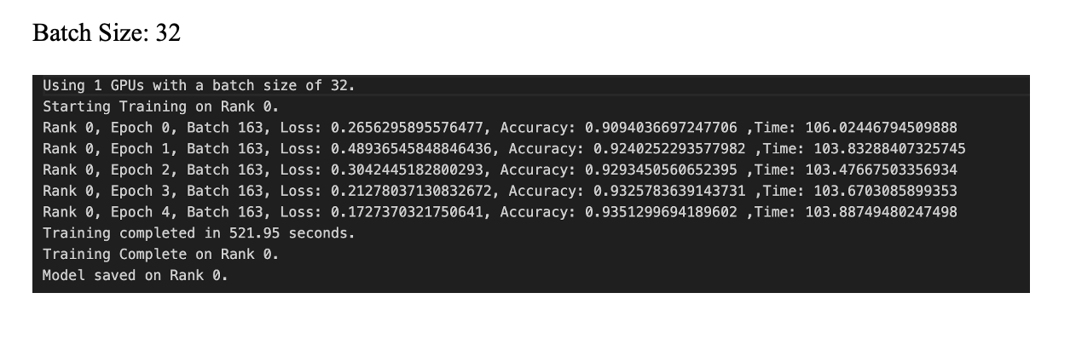
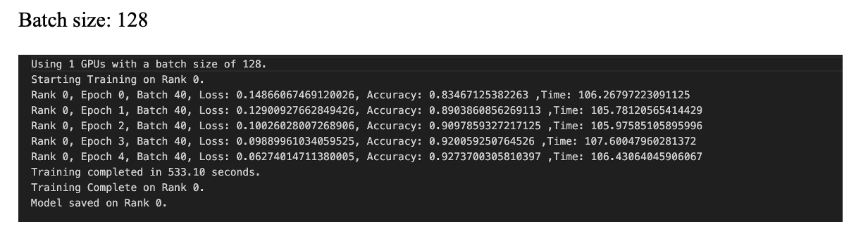
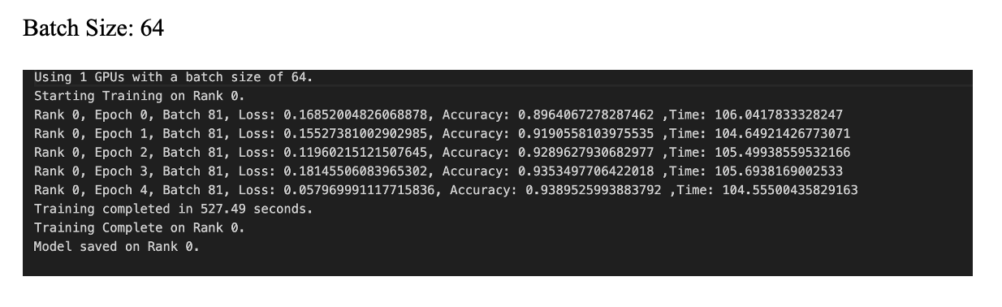
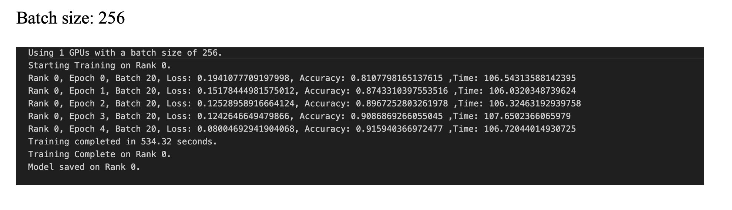
1 GPU

Slide 19
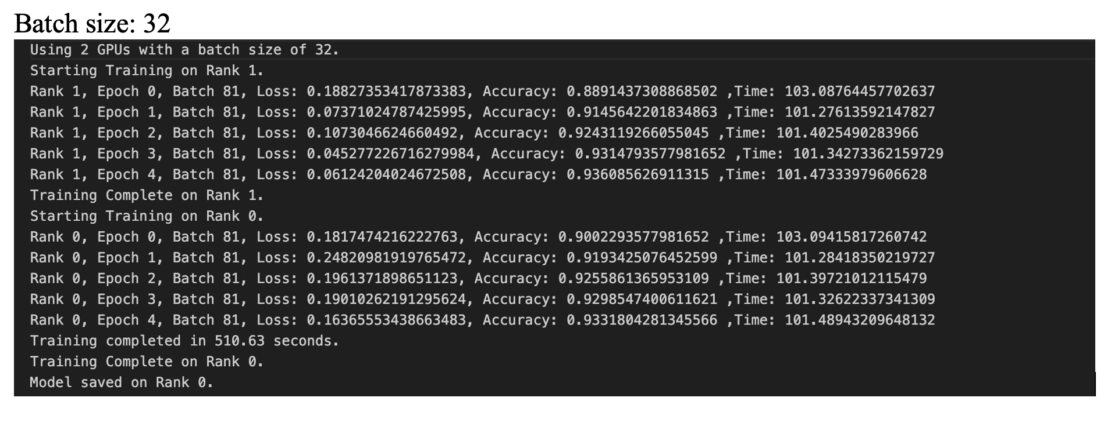
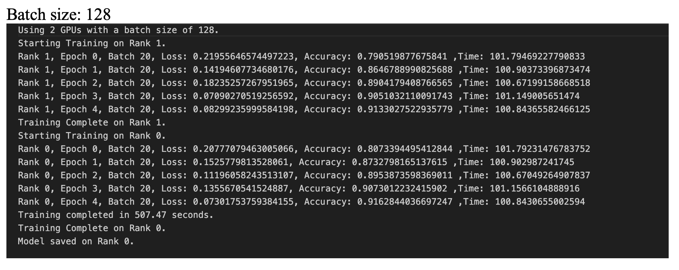
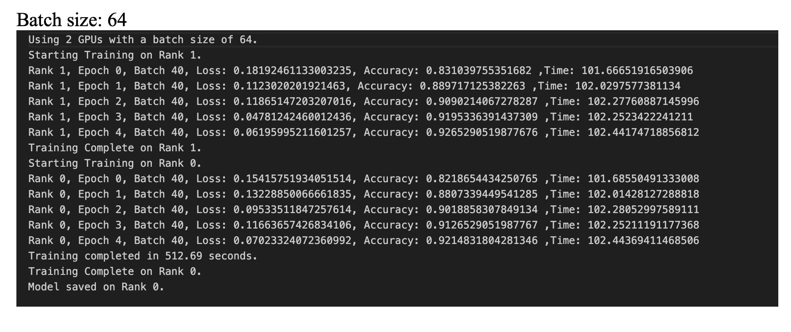
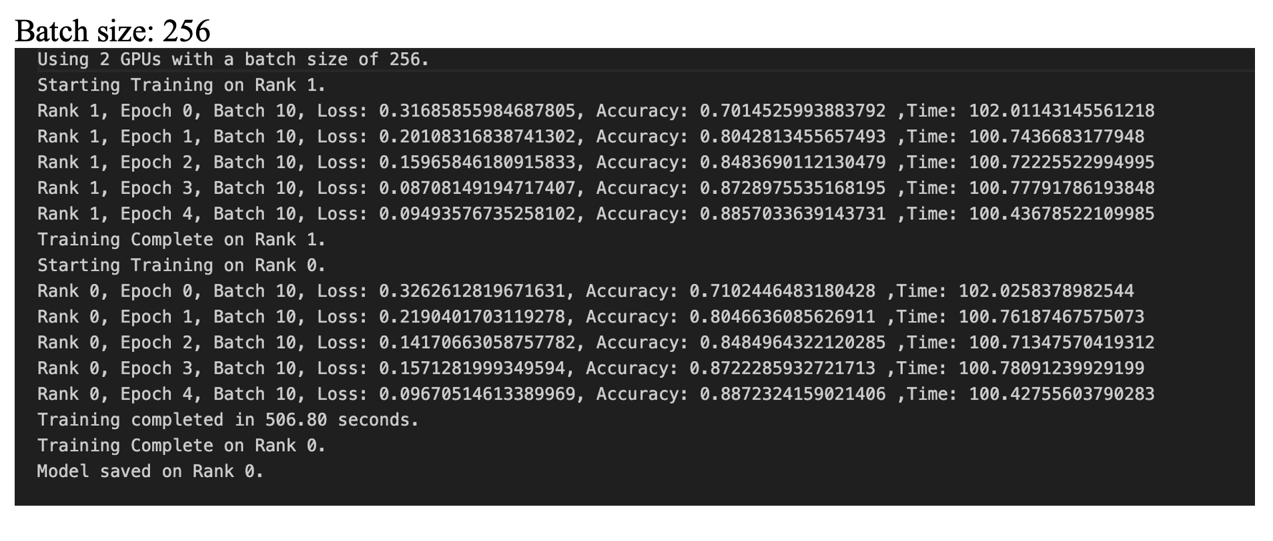
2 GPU​s

Slide 20
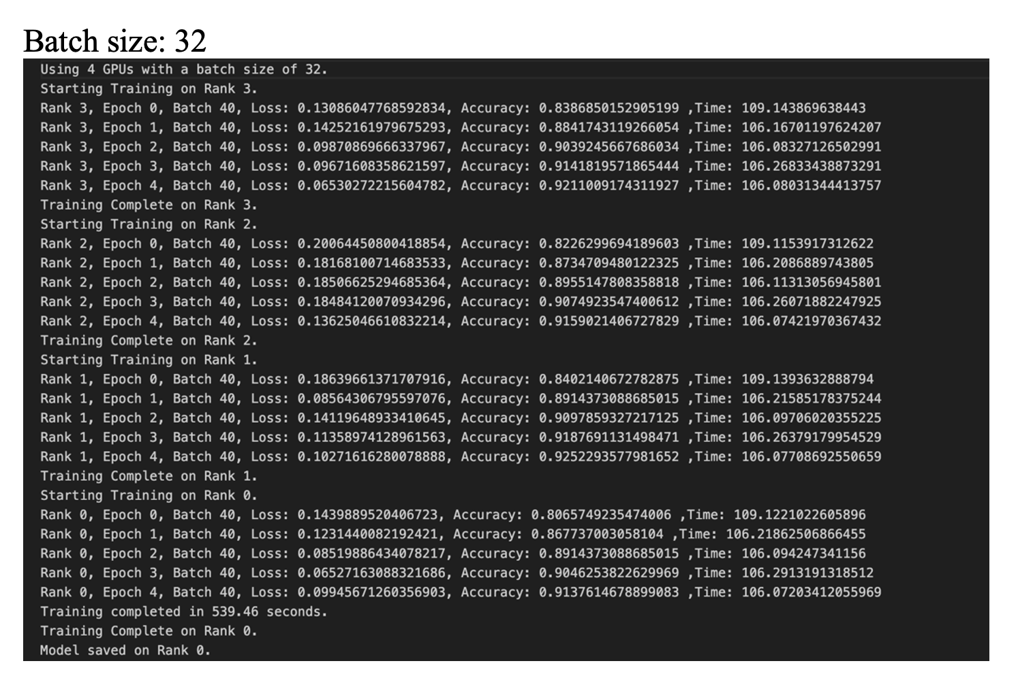
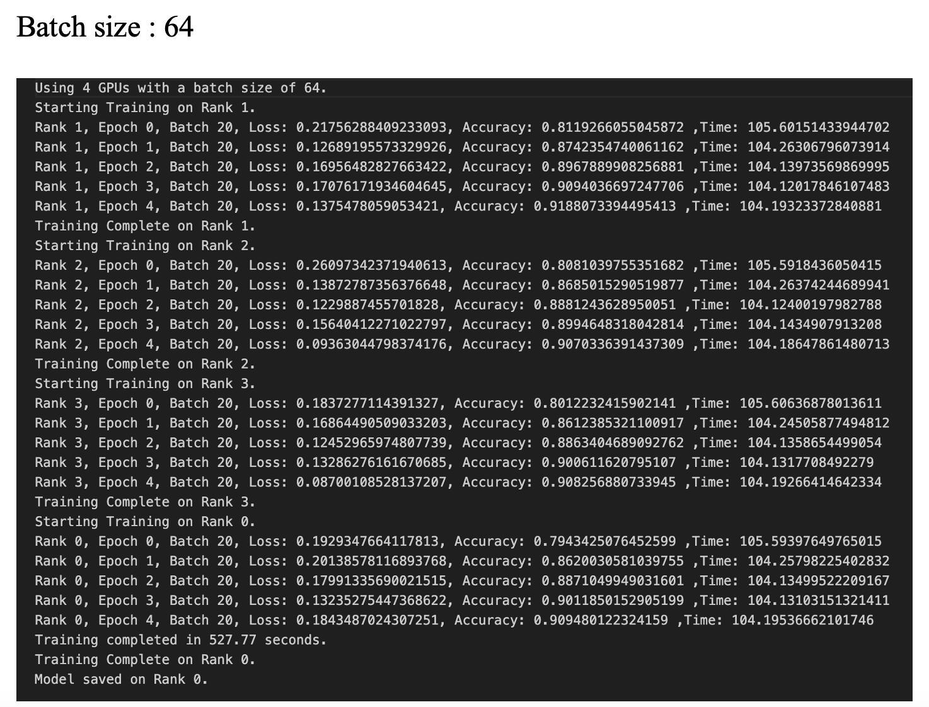
4 GPU​s

Slide 21
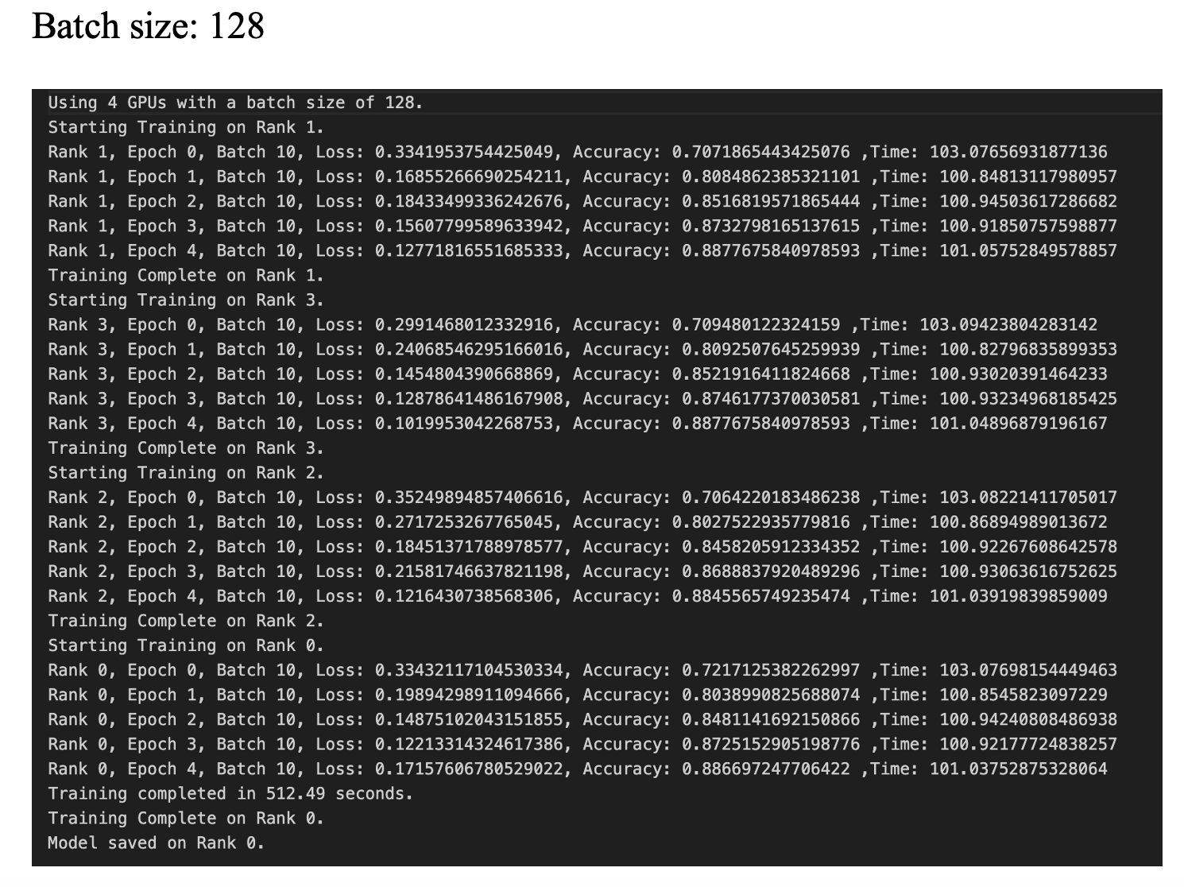
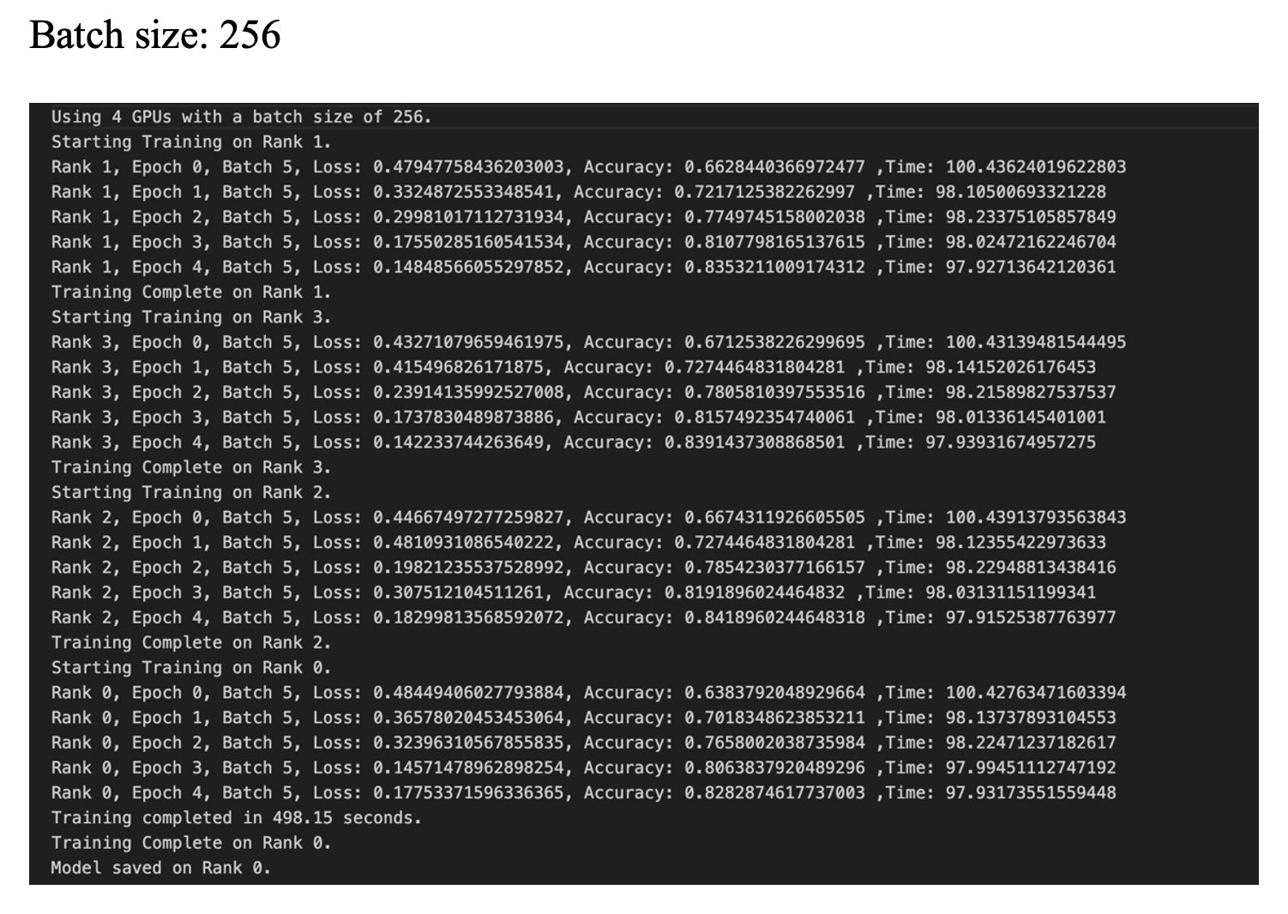
4 GPU​s​

Slide 22
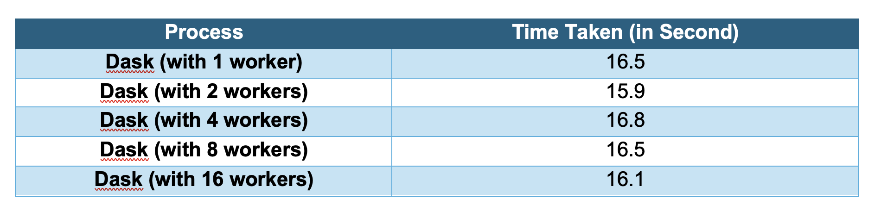
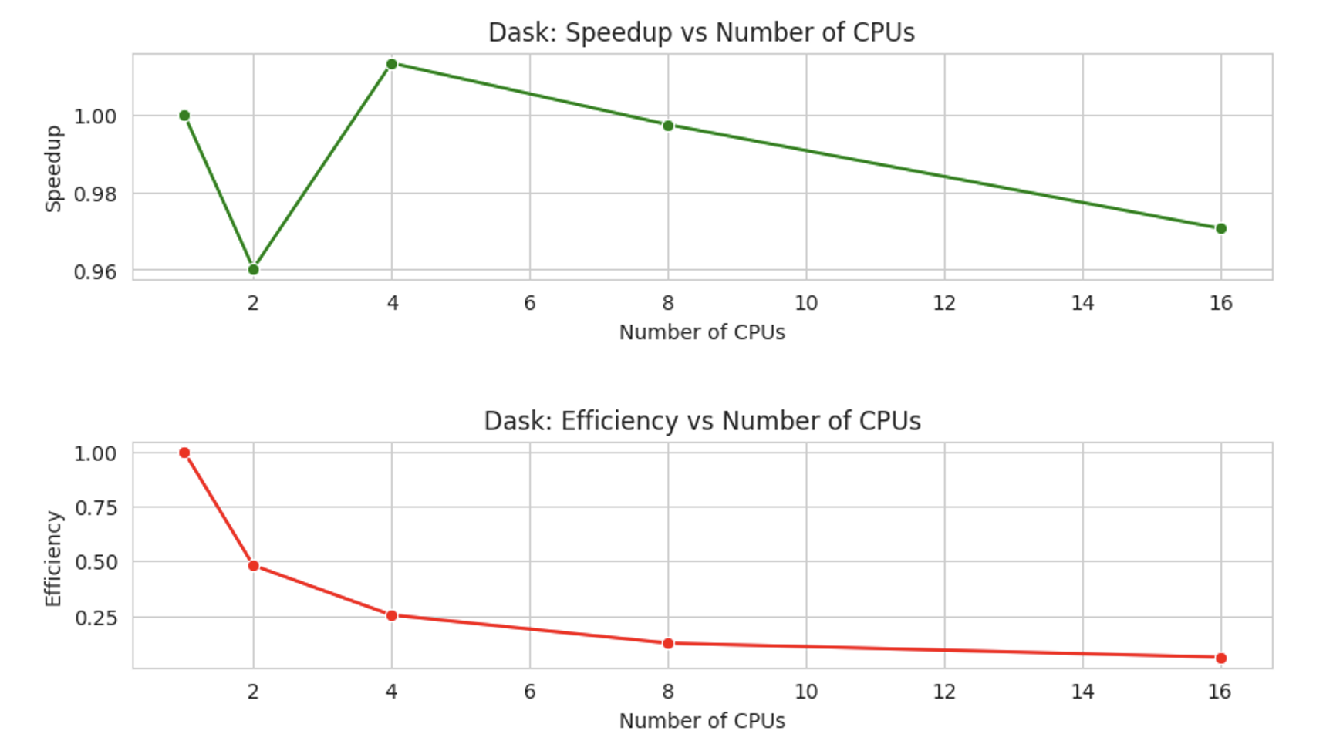
Results: Dask Performance Evaluation

Slide 23
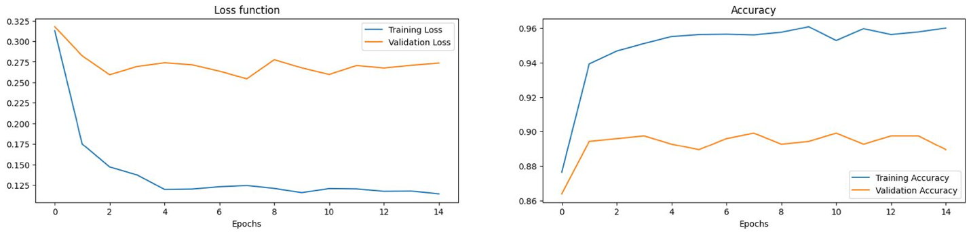
Model Evaluation
The model’s loss decreased and converged for both training and validation datasets, indicating effective learning without significant overfitting.
Accuracy for both training and validation increased and aligned closely by the end of training, suggesting excellent model generalization.
High final accuracy rates (~0.96) across both datasets demonstrate the model's strong performance in pattern recognition within the data.

Slide 24
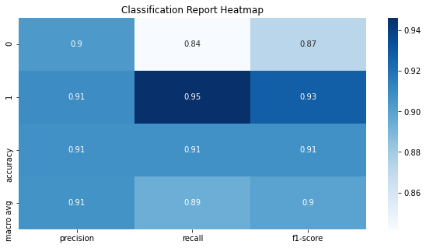
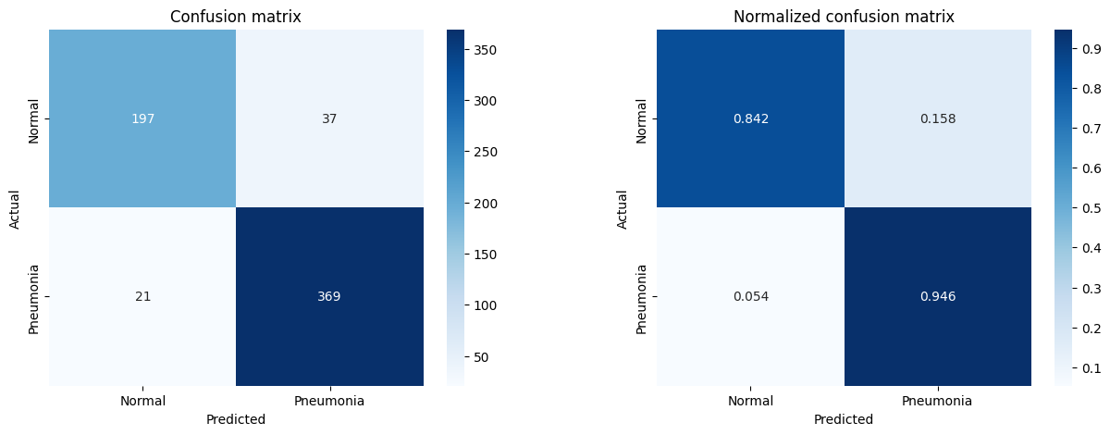
Confusion Matrix

Slide 25
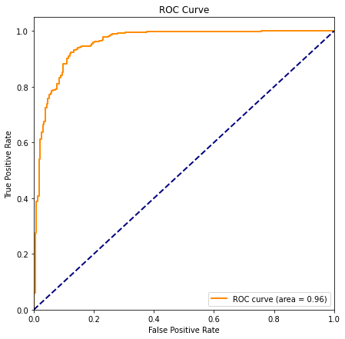
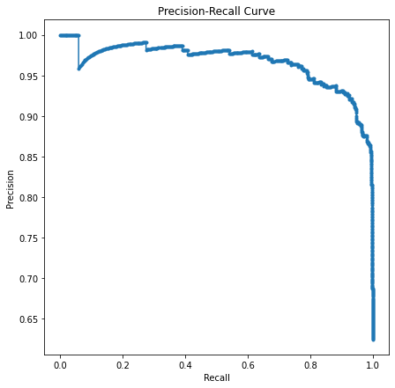

Slide 26
Conclusion
Single-core synchronous execution is the baseline for performance, being the slowest method.
Multiprocessing reduces data loading time, optimizing resource use in data-heavy tasks.
DenseNet-161 with transfer learning accurately classifies chest X-rays.
DDP across multiple GPUs significantly shortens training time over single-GPU or CPU methods.
Larger batch sizes on 4-GPU setups with DDP improve efficiency and training speed.
Dask minimizes evaluation time while maintaining accuracy, enhancing workflow speed.
Optimal GPU count and batch size balance are key for best training efficiency and accuracy.

Slide 27
References
https://docs.python.org/3/library/multiprocessing.html
https://docs.dask.org/en/stable/
https://pytorch.org/tutorials/intermediate/ddp_tutorial.html
https://pytorch.org/docs/stable/index.html
https://data.mendeley.com/datasets/rscbjbr9sj/2
https://www.kaggle.com/code/writabrata/pneumonia-densenet121-82-accuracy
https://pytorch.org
https://medium.com/codex/a-comprehensive-tutorial-to-pytorch-distributeddataparallel-1f4b42bb1b51
https://pytorch.org/tutorials/intermediate/ddp_tutorial.html
https://www.kaggle.com/code/piehtvh/class-weight-for-imbalanced-pediatric-dataset
https://tutorial.dask.org/03_dask.delayed.html

Slide 28


